Slide 1
Where do I build my factory?
Factors influencing the location of industry.

Slide 2
What do you need to think about?
Location
Factors
Resource
Materials
Markets
Transport
Facilities
Labour
Services
Capital
Government/
EU Policy
Preferred place
Of the
Owner

Slide 3
How do these things influence where factories are built?
Resource Materials: These
are the raw materials or semi
finished products that the
factory needs to make things.
If the resource materials are
big and heavy, the factory will
need to be built close to the
resource materials.
If not it would be too difficult
and expensive to move the
resource materials to the
factory.

Slide 4
How do these things influence where factories are built?
2. Markets: Access to markets means being close to the places where
you are going to sell your products and the customers who are going to
buy them. The closer you are the less transport costs you will have to
pay to distribute your goods. Therefore you can do it faster and
cheaper.
3. Transport Facilities: All factories need to transport their finished
products to their customers. If the products are to be sold in the same
country then good road or rail transport is required. If the company is
exporting their products they will need to be close to the airport or a
port.

Slide 5
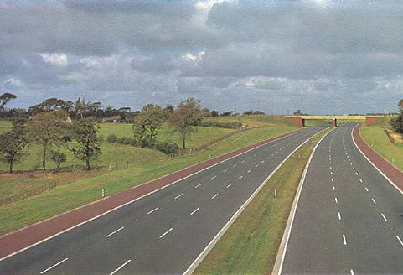
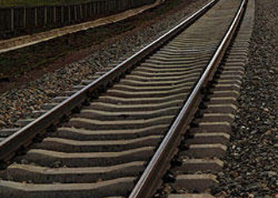
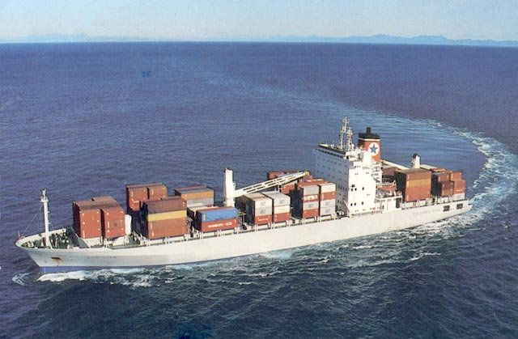
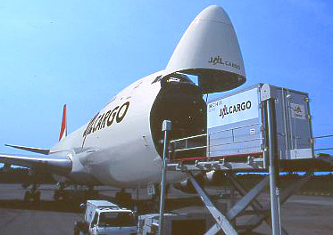
How are Goods Transported?
Transport is one of the biggest costs an industry has. Therefore it will locate as near as possible to a good road network that will connect it to other transport routes and /or its market.
That is why industries locate on the edges of towns or cities near motorways.

Slide 6

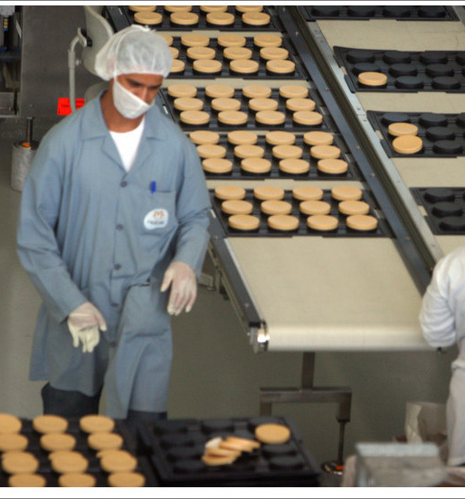
How do these things influence where factories are built?
4. Labour: Labour means
the workforce.
All factories need workers and so
the factory must be built where
there are enough workers.
Some factories require low
skilled workers.
Other companies may require
highly skilled university
graduates to work in their
factories. For example, apple.

Slide 7
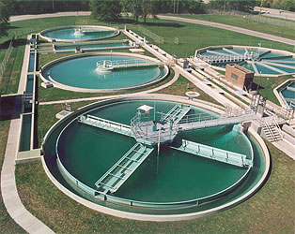
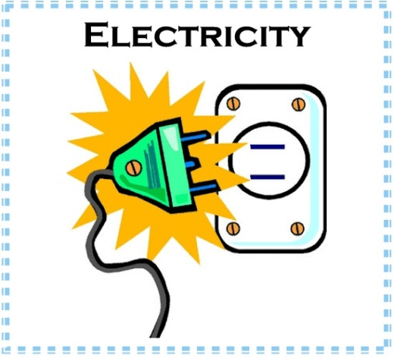


How do these things influence where factories are built?
5. Services: Services means having things like electricity, water, sewage
treatment, telephone, and broadband internet access. Most companies need
good quality services and so they set up only were these things are available.

Slide 8


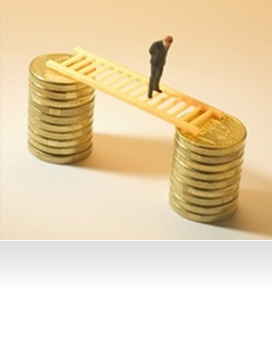
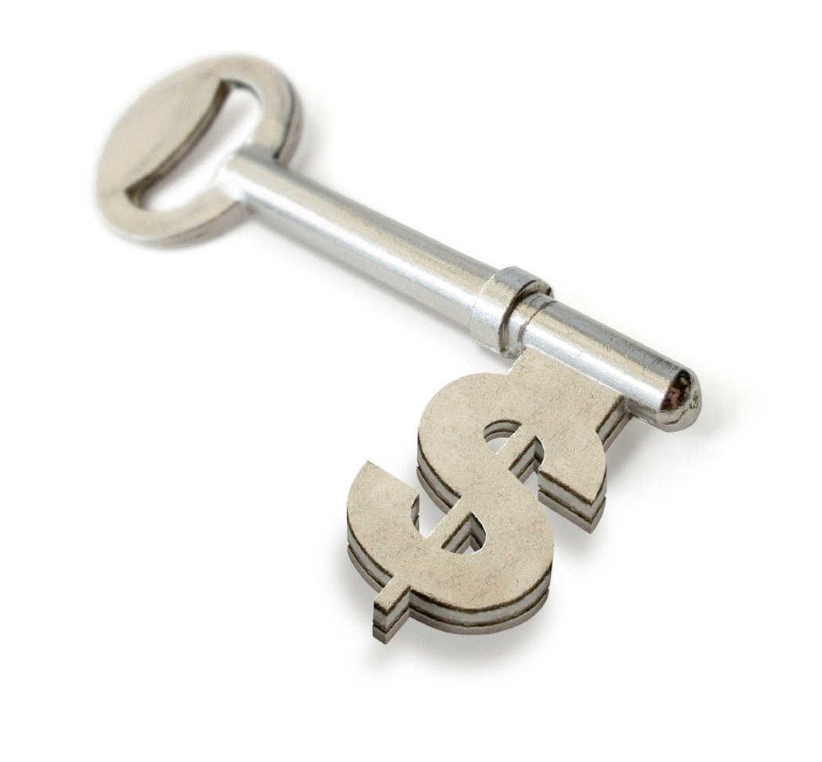
How do these things influence where factories are built?
6. Capital: Capital means the money the company needs to set up
their factory. They may need to get investment from banks to help with
these costs.

Slide 9
How do these things influence where factories are built?
7. Government/EU Policy:
Governments do many things to
encourage companies to set up in
their country.
The Irish government gives grants to
companies who set up here. We also
have a low corporate tax rate. They
may also build factories for the
companies and pay money towards
training workers.
Q. How has membership of the EU helped Ireland attract companies to set up here.

Slide 10
How do these things influence where factories are built?
8. Preferences of Business person/local communities:
Some people may set up a factory in an area where they like or were
they come from.
Local people often are happy when companies set up in their area
because it provides jobs.
However, other people may not want factories because it increases the
traffic and the number of trucks on the road. It may also cause noise,
visual, and air pollution.

